Slide 1
CS310 Operating Systems Lecture 42: File System Design
Ravi Mittal
IIT Goa

Slide 2
Acknowledgements !
Contents of this class presentation has been taken from various sources. Thanks are due to the original content creators:
CS162, Operating System and Systems Programming, University of California, Berkeley
Book: Modern Operating Systems by Andrew Tanenbaum and Herbert Bos
Book: Operating System Concepts, 10th Edition, by Silberschatz, Galvin, and Gagne

Slide 3
File System - Data Structure (Unix/Linux)

Slide 4
From Storage to File Systems
I/O API and
syscalls
Variable-Size Buffer
Memory Address
Logical Index, Typically 4 KB
File System
Block
Flash Trans. Layer
Hardware Devices
Sector(s)
Sector(s)
Sector(s)
Phys. Block
Phys Index., 4KB
Physical Index,
512B or 4KB
Erasure Page
HDD
SSD
CS162 © UCB Fa19

Slide 5
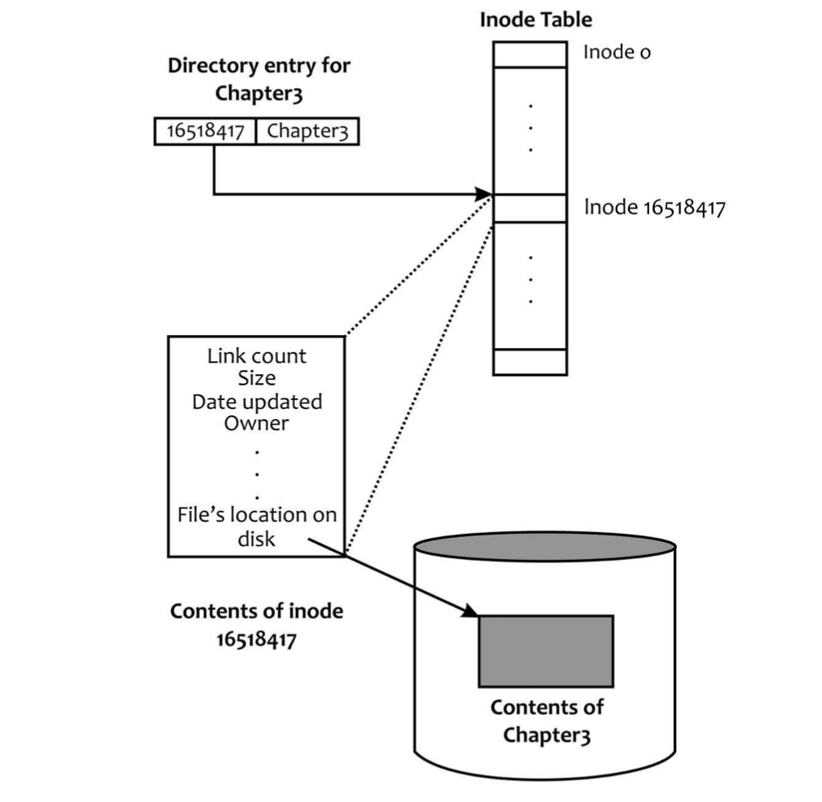
Directory Entry, inode, and file contents
Adapted from: Linux: The Textbook by Sarwar and koretsky

Slide 6
Directory Entry, inode, and file contents
Adapted from: Linux: The Textbook by Sarwar and koretsky

Slide 7
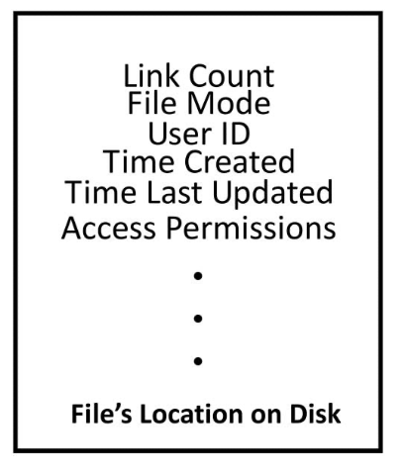
Contents of inode
Adapted from: Linux: The Textbook by Sarwar and koretsky

Slide 8
Inode diagram
inode
File info
Direct blocks
Indirect blocks
Double
Indirect
Blocks

Slide 9
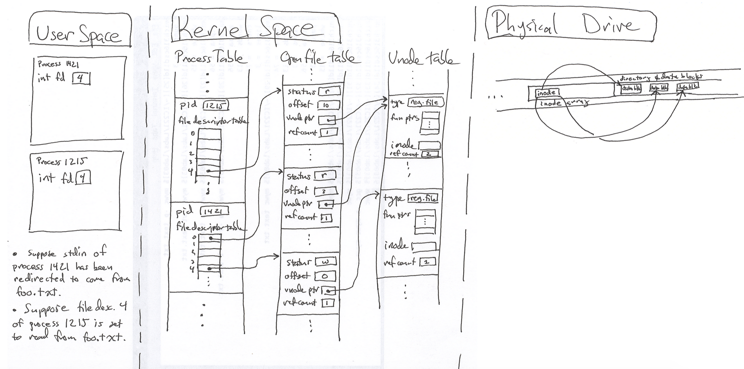
Big Picture
https://www.usna.edu/Users/cs/wcbrown/courses/IC221/classes/L09/Class.html

Slide 10
Today we will study
File System Design Concepts
File System Layout
Allocation of blocks to files
FAT: File Allocation Table
Unix / Linux File Sytem

Slide 11
File System Design - Concepts

Slide 12

Translating from User to Sys. View
File (Bytes)
File
System
What happens if user says: "give me bytes 2 – 12?"
Fetch block corresponding to those bytes
Return just the correct portion of the block
What about writing bytes 2 – 12?
Fetch block, modify relevant portion, write out block
Everything inside file system is in terms of whole-size blocks
Actual disk I/O happens in blocks
read/write smaller than block size needs to translate and buffer
CS162 © UCB Fa19

Slide 13
Disk Management
The disk is accessed a linear array of sectors
How to identify a sector? Two Options:
Physical position
Sector is a vector [cylinder, surface, sector]
This method is not used anymore
OS/BIOS must deal with bad sectors
Logical Block Addressing (LBA)
Every sector has an integer address
Control translates from address to physical position
Shields OS from disk structure

Slide 14
File System Layout

Slide 15
File System Layout
File systems are stored on disks
Disks can be divided up into one or more partitions
Each partition with independent file system
Sector 0 of disk is the Master Boot Record (MBR)
Used to boot the computer
After MBR is the partition table
It has starting and ending addresses of each partition
One of the partition is marked as active in the master boot table
To boot computer, BIOS reads and executes MBR
MBR finds active partition and reads in first block (boot block)
The program in the boot block loads the operating system contained in that partition
Every partition starts with boot block
Modern OS: Tanenbaum and Bos

Slide 16
A possible File System Layout
Tanenbaum, Modern Operating Systems

Slide 17
File System Layout
Super block contains all key parameters about the file system
It is read into the memory when the computer is booted or file system is first touched
File system type, the number of blocks in the file system etc
Free space management
Information about free blocks in the file system
Bit map or list of pointers
i-nodes
An array of data structures for each file – tells about the file
Root Directory
Remainder of the disk contains other directories and files
Tanenbaum, Modern Operating Systems

Slide 18
Allocation of Blocks to Files

Slide 19
Allocating Blocks to Files
Contiguous Allocation
Linked List Allocation
Linked list using table
i-nodes
Tanenbaum, Modern Operating Systems

Slide 20
Allocating Blocks to Files
Contiguous Allocation
Linked List Allocation
Linked list using table
i-nodes
Tanenbaum, Modern Operating Systems

Slide 21
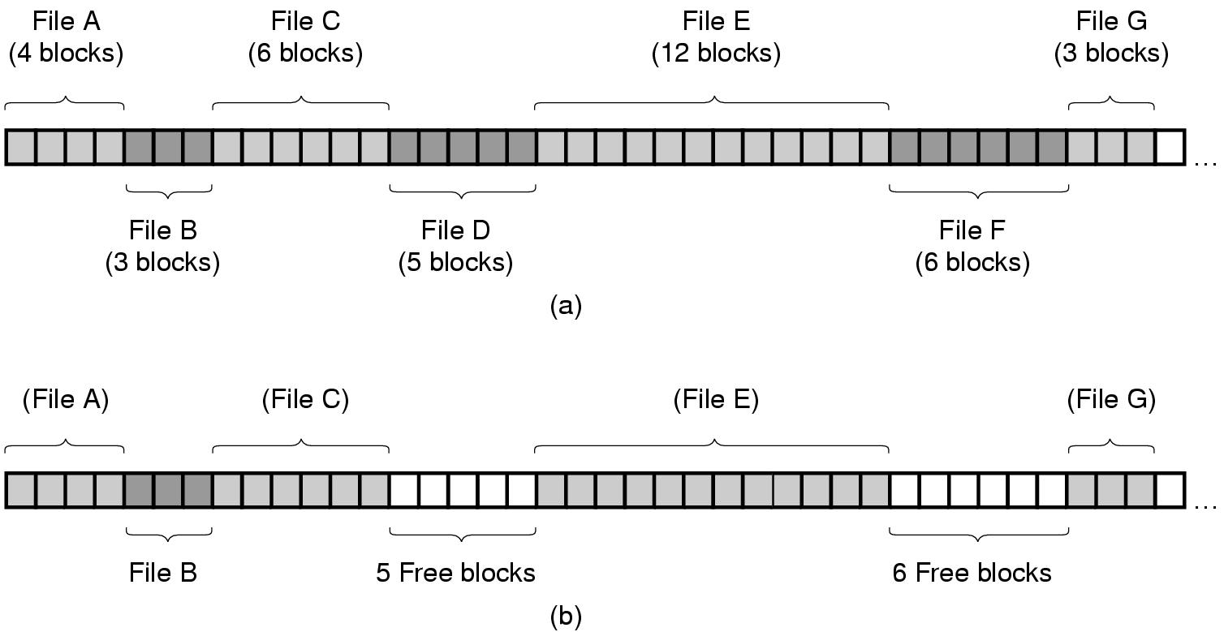
Contiguous Allocation
(a) Contiguous allocation of disk space for 7 files
(b) The state of the disk after files D and F have been removed.
Tanenbaum, Modern Operating Systems

Slide 22
Contiguous Allocation
Fragmentation – the main issue
Used in CD-ROMs

Slide 23
Allocating Blocks to Files
Contiguous Allocation
Linked List Allocation
Linked list using table
i-nodes
Tanenbaum, Modern Operating Systems

Slide 24
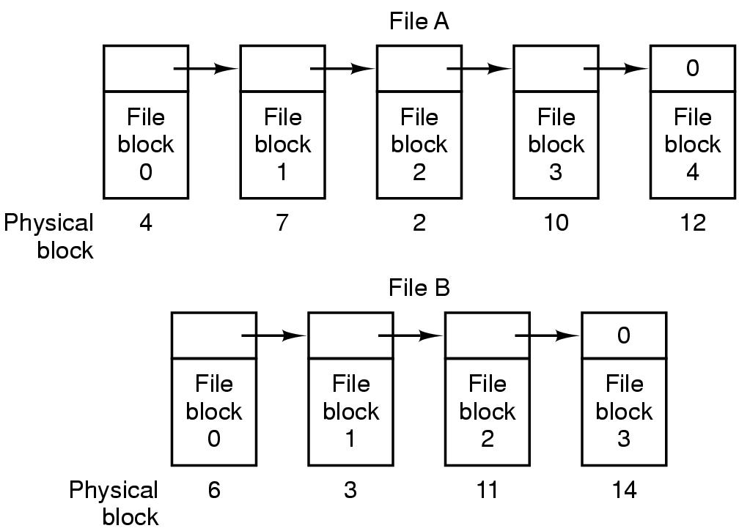
Linked List Allocation
Storing a file as a linked list of disk block
Slow random access
No fragmentation
Tanenbaum, Modern Operating Systems

Slide 25
Allocating Blocks to Files
Contiguous Allocation
Linked List Allocation
Linked list using table – File Allocation Table
i-nodes
Tanenbaum, Modern Operating Systems

Slide 26
FAT: File Allocation Table
MS-DOS, 1977
Still widely used!

Slide 27
File Allocation Table (FAT)
Simple file system popularized by MS-DOS
First introduced in 1977
Most devices today use the FAT32 spec from 1996
FAT12, FAT16, VFAT, FAT32, etc.
Still quite popular today
Default format for USB sticks and memory cards

Slide 28
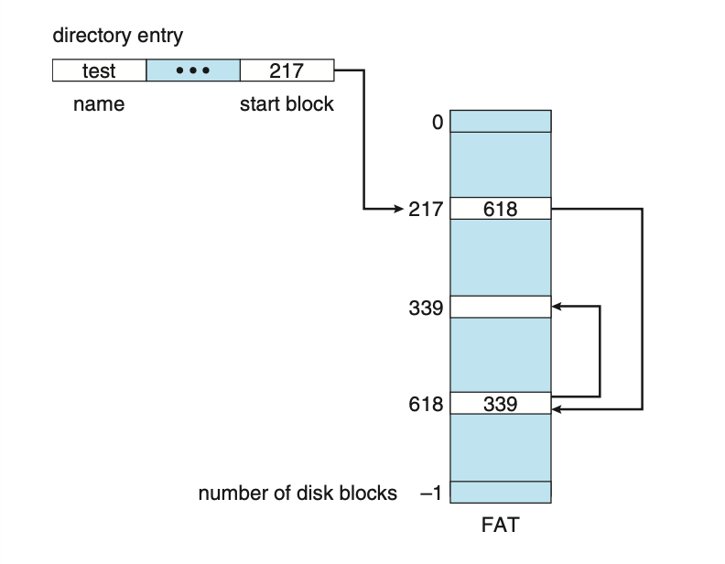

Linked List using a table in memory - FAT
File Allocation Table
Table has one entry for each block
Operating System Conecpts: Silberschatz, Galvin, Gagne

Slide 29
Stores basic info about the file system
FAT version, location of boot files
Total number of blocks
Index of the root directory in the FAT
File allocation table (FAT)
Marks which blocks are free or in-use
Linked-list structure to manage large files
Store file and directory data
Each block is a fixed size (4KB – 64KB)
Files may span multiple blocks
Super Block
Disk

Slide 30








Directories are special files
File contains a list of entries inside the directory
Possible values for FAT entries:
0 – entry is empty
1 – reserved by the OS
1 < N < 0xFFFF – next block in a chain
0xFFFF – end of a chain
Windows
C:\
Users
pagefile.sys
2
3
4
5
6
7
8
9
2
3
4
5
6
7
8
9
Super Block
Disk
C:\
Name | Index | Dir? | Perms
. | 2 | Y | rwx
Windows | 3 | Y | rwx
Users | 4 | Y | rwx
pagefile.sys | 5 | N | r
Root directory index = 2

Slide 31
FAT - Properties
The Good –
Hierarchical tree of directories and files
Variable length files
Basic file and directory meta-data
The Bad
At most, FAT32 supports 2TB disks
Locating free chunks requires scanning the entire FAT
Prone to internal and external fragmentation
Large blocks → internal fragmentation
Reads require a lot of random seeking

Slide 32


Lots of Seeking
FAT may have very low spatial locality, thus a lot of random seeking
Consider the following code:
int fd = open(“my_file.txt”, “r”);
int r = read(fd, buffer, 1024 * 4 * 4); // 4 4KB blocks
56
57
58
59
60
61
62
63
64
65
67
68
FAT
67
0xFFFF
0
0xFFFF
63
0
56
57
0
0
59
60
56
57
58
59
60
61
62
63
64
65
67
68
Blocks

Slide 33
Allocating Blocks to Files
Contiguous Allocation
Linked List Allocation
Linked list using table
i-nodes
Tanenbaum, Modern Operating Systems

Slide 34
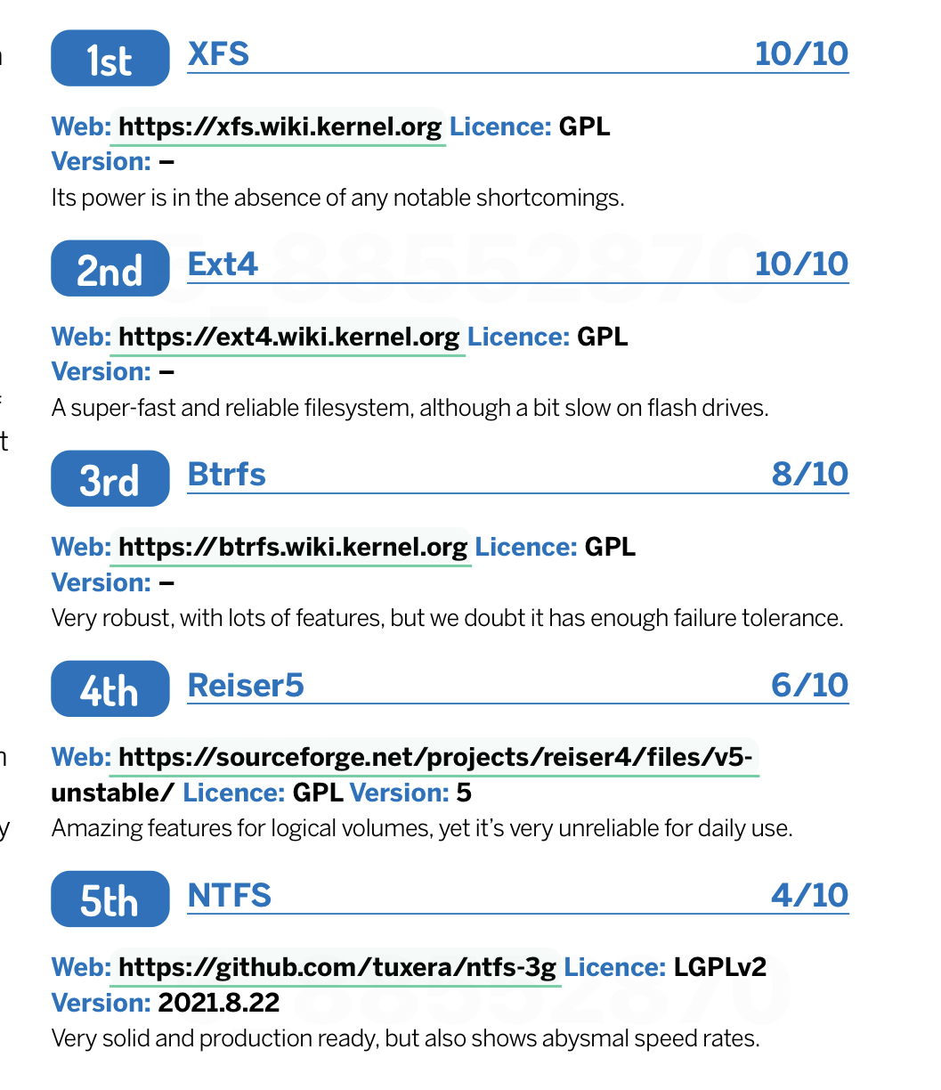
Modern File system for Linux

Slide 35
Unix Fast File System (Berkeley FFS)

Slide 36
i-node (Linux File System)
Efficiency of FAT is very low
Lots of seeking over file chains in FAT
Only way to identify free space is to scan over the entire FAT
Linux file system uses more efficient structures
Extended File System (ext) uses index nodes (inodes) to track files and directories

Slide 37
Size Distribution of Files
FAT uses a linked list for all files
Simple and uniform mechanism
… but, it is not optimized for short or long files
Question: are short or long files more common?
Studies over the last 30 years show that short files are much more common
2KB is the most common file size
Average file size is 200KB (biased upward by a few very large files)
Key idea: optimize the file system for many small files

Slide 38
Inodes in Unix (Including Berkeley FFS)
Original inode format appeared in BSD 4.1 (more following)
Index structure is an array of inodes
File Number (inumber) is an index into the array of inodes
Each inode corresponds to a file and contains its metadata
Inode maintains a multi-level tree structure to find storage blocks for files
Great for little and large files
Asymmetric tree with fixed sized blocks

Slide 39
Inode Structure
CS162 at UC Berkeley

Slide 40
Inode Structure
User
Group
9 basic access control bits
- UGO x RWX
SetUID bit
- execute at owner permissions rather than user
SetGID bit
- execute at group’s permissions
CS162 at UC Berkeley
Notes:
Information contained in an inode:
File size
Device on which the file is stored
User and group IDs associated with the file
Permissions needed to access the file
Creation, read, and write timestamps
Location of the data (though not the filepath)

Slide 41
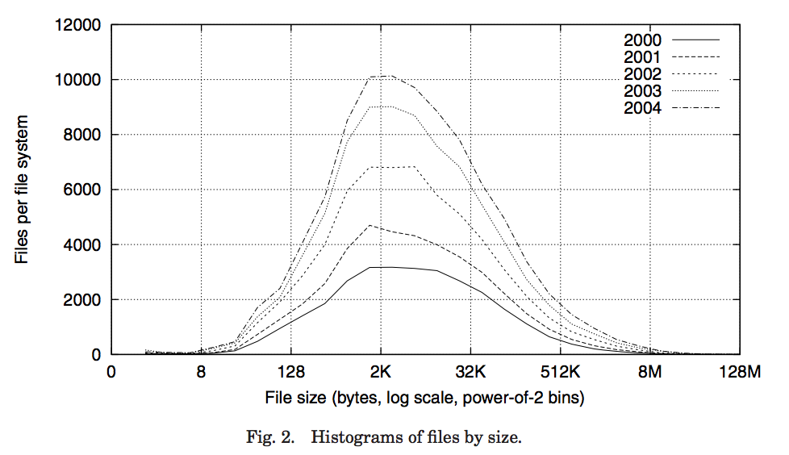
Small Files: 12 Pointers Direct to Data Blocks
Direct pointers
4kB blocks ⇒ sufficient for files up to 48KB
CS162 at UC Berkeley

Slide 42
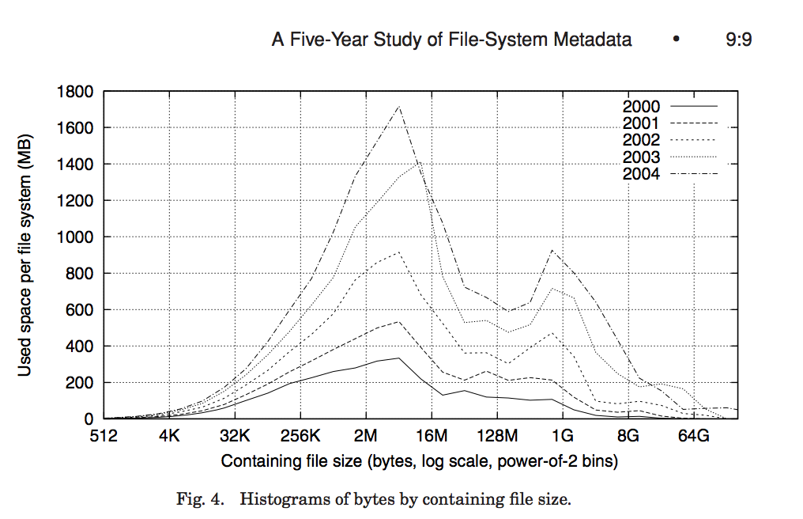
Large Files: 1-, 2-, 3-level indirect pointers
Indirect pointers
- point to a disk block
containing only pointers
- 4 kB blocks => 1024 ptrs
=> 4 MB @ level 2
=> 4 GB @ level 3
=> 4 TB @ level 4
48 KB
+4 MB
+4 GB
+4 TB
CS162 at UC Berkeley

Slide 43
Advantages of inodes
Optimized for file systems with many small files
Each inode can directly point to 48KB of data
Only one layer of indirection needed for 4MB files
Faster file access
Greater meta-data locality → less random seeking
No need to traverse long, chained FAT entries
Easier free space management
Bitmaps can be cached in memory for fast access
inode and data space handled independently

Slide 44
Lecture Summary
File System:
Transforms blocks into Files and Directories
Optimize for size, access and usage patterns
Maximize sequential access, allow efficient random access
FAT: File Allocation Table
Very popular (DOS)
File indexes into simple table, find blocks by traversing linked list
Simple; table size may become very big for large disk (eg 2-4 TB); Lots of seeks
FFS (Linux/Unix)
inode file index structure
Asymmetric, multi-level tree
One block per leaf of tree

Slide 45
Super block, storing:
Size and location of bitmaps
Number and location of inodes
Number and location of data blocks
Index of root inodes
Table of inodes
Each inode is a file/directory
Includes meta-data and lists of associated data blocks
Bitmap of free & used data blocks
Bitmap of free & used inodes
Data blocks (4KB each)

